Slide 1

SEO 101
Helena, Montana Montana SBDC Lead Center

Slide 2

How is SEO calculated?
Every website gets a “quality score”
Quality score is like a credit rating
Can be “programmed in” on back end (Paid)
Also Influenced by:
Website Longevity
Amount of Searches by Customers
Inbound/Outbound links to your Website
Keywords in your Website

Slide 3
Tips to Improve
Brainstorm all keywords/phrases; put on every page of your website creatively
Type in captions on products
Rename any and all images with relevant names
Put yourself in directories/review sites/ blogs (ask!) “Outbound”
Link to other pages on your website (“Press”, etc.) “Inbound”
Use “tags” on your website—tutorial on this link: https://blog.kissmetrics.com/website-source-code-seo/

Slide 4
Look at Competitors
Look nationally, regionally and statewide
What are they doing right?
Copy them!

Slide 5
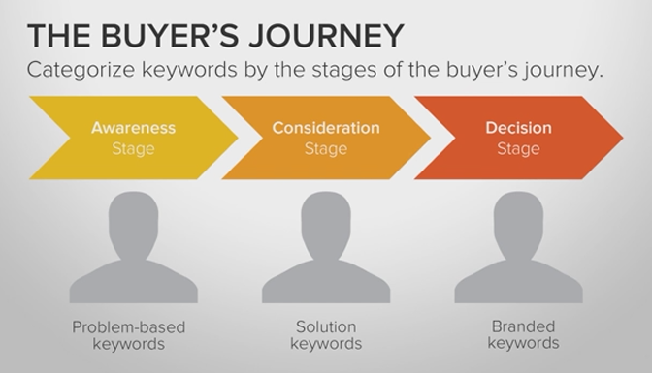
Research all questions the buyer could be asking themselves from every stage of their purchase. The awareness stage begins with a question like “how to dry out your iphone” – if you sold cell phone cases you’d be meeting that solution. Implement as a blog into your website.

Slide 6
Any Questions?

