Slide 1

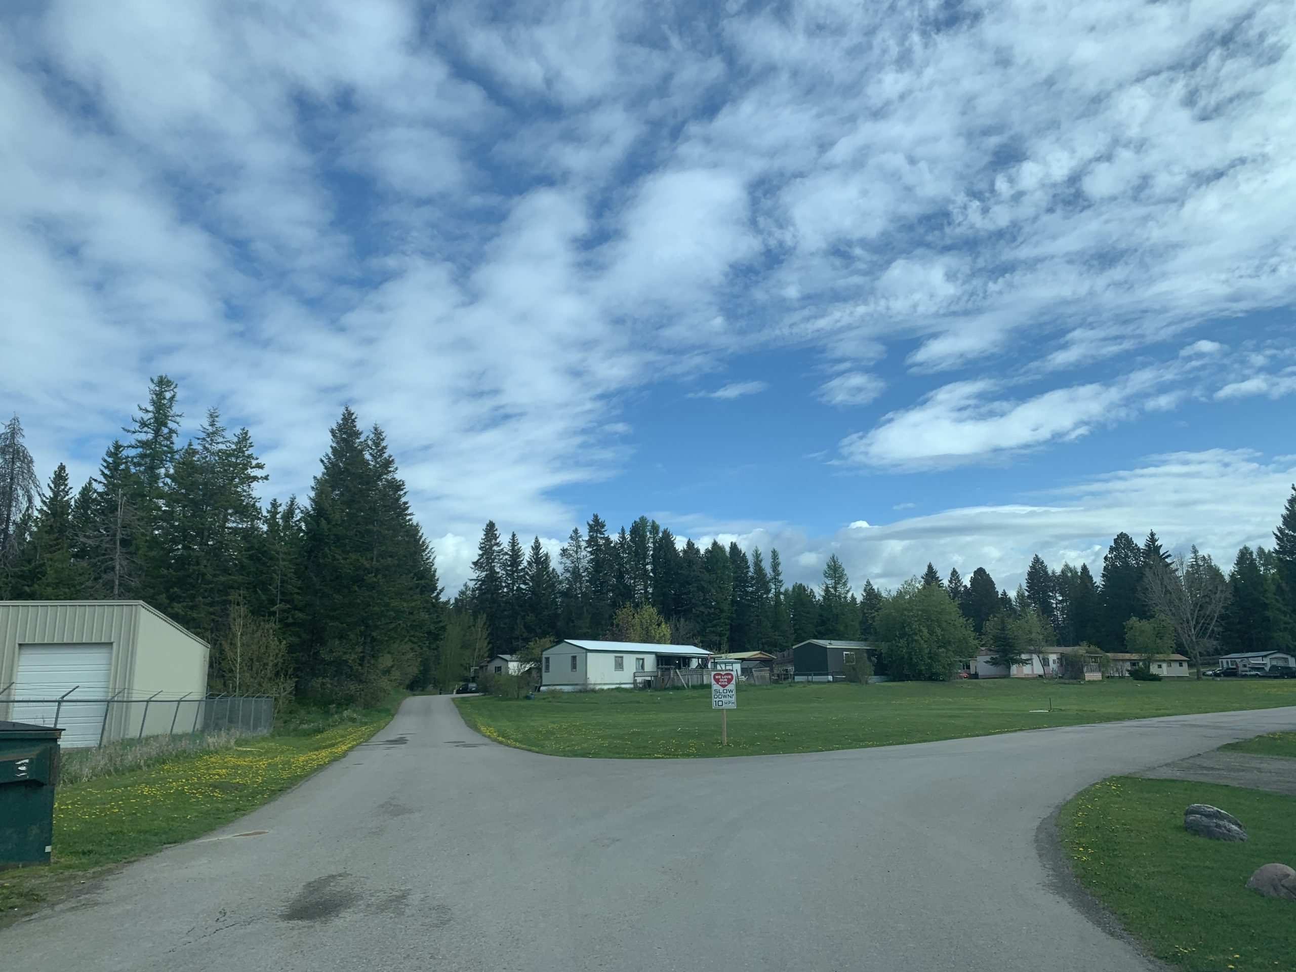
PRESERVATION AND REINVESTMENT INITIATIVE FOR COMMUNITY ENHANCEMENT (PRICE) Montana Housing
Notes:
Slide 1
Good morning, I am pleased to be here to present the Montana Department of Commerce’s Preservation and Reinvestment Initiative for Community Enhancement, or PRICE, application. My name is Melissa Higgins, and I am the Housing Program Executive with the Department.

Slide 2
Overview
Competitive grants (25 Awards)
$200 million ($5M min/$75M max)
Preservation and revitalization of manufactured housing communities.
PRICE is a component of the Community Development Block Grant (CDBG) program
Notes:
PRICE is a competitive grant being administered by HUD which seeks to preserve and revitalize manufactured home communities.
It is a highly competitive grant and HUD will prioritize applicants that:
Demonstrate a compelling need for the preservation or revitalization of manufactured home communities;
Evaluate how manufactured housing and manufactured home communities contribute to the local affordable housing stock; and
Has a commitment to affirmatively furthering fair housing.
PRICE funds use the Community Development Block Grant, or CDBG, framework. This means that statutes and regulations governing the CDBG program apply to PRICE funds; though the Notice of Funding Opportunity contains certain exceptions and waivers.
As with all CDBG assistance, the priority is to serve low- and moderate-income people

Slide 3
PRICE
Eligible Uses
ACQUISITION
INFRASTRUCTURE
PLANNING
REPAIR, REHAB, REPLACE
RESIDENT AND COMMUNITY SERVICES
RESILIENCE
ENVIRONMENTAL IMPROVEMENT
Notes:
The Montana Department of Commerce has chosen to build on the successes already achieved by NeighborWorks Montana and partner with them, focusing our efforts on four strategies and related activities as part of our PRICE request.
To that end, the Department proposed the following activities:
Resident Ownership
Infrastructure Improvement
Alternative Park Preservation; and
New Park Development.
While replacement of pre-HUD code manufactured homes is another core area of need it is not the focus of this application. Critical barriers including local developer capacity, underlying local regulatory barriers, and non-profit partner capacity will be important factors for us to address in future home replacement program work. It is our strong hope that PRICE funds will be available again in the future, and home replacement can be the focus of a future PRICE application.

Slide 4
GOALS AND OBJECTIVES
Increase Housing Supply and Affordability.
Preserve and Revitalize Existing Manufactured Homes and Communities
PRICE
Support Accessibility Modifications, Repairs, and Replacement
Increase Resilience
Promote Homeownership – Advance Resident Owned Communities.
8
Notes:
The goals and objectives of the PRICE opportunity are to:
Increase housing supply and affordability for people of modest means nationwide, including in urban, suburban, rural, and tribal areas
Preserve and revitalize existing manufactured housing and manufactured housing communities Increase resilience to extreme weather, natural hazards, and disaster events, support energy efficiency, and protect the health and safety of manufactured housing residents
Promote homeownership opportunities and advance resident-controlled sustainable communities through new and revitalized units of manufactured housing that will remain affordable
Support accessibility modifications, repairs, and replacement of deteriorating manufactured housing units – especially to increase accessibility and access for persons with disabilities, facilitate aging in place for older adults and increase access to affordable housing for low-income households

Slide 5
Communities Served
Kalispell, Columbia Falls, Belgrade, Havre, Great Falls, Pablo/Ronan, Libby, Missoula, Lolo, Emigrant, Livingston, Columbus
Notes:
Implementing these proposed activities will allow the Department to provide:
stabilization, infrastructure, and infill support for 134 households
Infrastructure improvements for 471 households; and
Preservation for 133 households.
Completing 25 projects across 21 mobile home communities, for a total of 763 homes preserved or created.
In addition, NWMT provides ongoing technical assistance to communities, including assistance with implementing community plans such as capital improvements and community management, assistance with governance of the ROCs including training and education for members and leadership, assistance with loan and grant compliance, and support with community projects.

Slide 6
Long-Term Effect
Increasing housing supply for LMI household’s parks.
Preserving and revitalizing resident owned Manufactured Home Communities.
Increasing the resilience of existing and newly created Manufactured Home Communities.
Promoting homeownership and advancing resident-controlled sustainable communities.
Notes:
All proposed activities will meet the CDBG national objective of providing benefit to LMI persons. All PRICE activities will assist in preserving and revitalizing MHCs. This work will be conducted across multiple sites and is focused on advancing projects with existing affordable housing partners including NWMT, HRDC, Community Land Trusts, and other non-profit partners active in this sector. The projects have been selected based on impact to LMI people and distressed communities, alignment with national objectives, and with local community housing priorities, readiness for completion within the six-year grant period, and commitment to long-term affordability with a preference for permanent affordability through resident ownership and/or community land trusts.

Slide 7
FOR MORE INFORMATION:
HOUSING MT
Montana Department of Commerce
HOUSING.MT.GOV
Melissa Higgins
Housing Program Executive
406.841.2092
Notes:
I am now available to answer any questions you may have and welcome your feedback.

