Slide 1
Housing Credits & Multifamily Loans
Board Member Training
April 14, 2025

Slide 2
Credits Timeline/Order of Events
Letter of Intent Submission Second Monday in April (4/14/2025)
Presentations/Board Invitation to Apply May Board Meeting (5/12/2025- 5/13/2025)
Application Submission First Monday in August (8/4/2025)
Award Determination October Board Meeting (10/20/2025)
LOI packets will be distributed to Board members for review a week before the May meeting
Developers will present proposals at the May meetings
LOI packets include the Letter of Intent Narrative, Letter of Intent attachment, and the Mini Market Study
These attachments include an overview of applicant information, project specifics, funding sources, income averages, etc.
Notes:
Currently 15 projects in the works. Due by 5pm today.

Slide 3
LOI Meeting and After Process
Board will review proposals and select up to 8 projects to invite for full application
Board decision making is discretionary
Geographical and Demographic guides provided in LOI packets
Full Applications are due the first Monday in August
Staff assess the Development Evaluation Criteria and conduct a financial analysis of the project’s Application
Selection Process at May and October meetings
Each Board Member will discuss their top 8 priority projects in May and their top priority projects in October, specifying their reasons for the priority projects selected
Common priority projects of Board Members are identified to generate a slate of projects for the Board to vote on

Slide 4
Specifics to Note for Selection
Required 10% Nonprofit Set Aside
Small Rural Project Spotlight
Tribal Spotlight
Maximum Credit Award of $8.5 Million
Community Vacancy
New Construction versus Acquisition Rehab
QCT/DDA/Discretionary Boost 130%
Total credit amount for 2026: $34,550,000

Slide 5
Selection Criteria
The geographical distribution of Housing Credit Projects;
The rural or urban location of the Projects;
Located in a QCT or DDA location;
The overall income levels targeted by the Projects (including deeper targeting of income levels);
The need for affordable housing in the community, including but not limited to current Vacancy Rates;
Rehabilitation of existing low-income housing stock;
Sustainable energy savings initiatives;
Financial and operational ability of the Applicant to fund, complete and maintain the Project through the Extended Use Period;
Past performance of an Applicant in initiating and completing Tax Credit Projects;
Cost of construction, land and utilities, including but not limited to costs/Credits per square foot/unit;
The Project is being developed in or near a historic downtown neighborhood;
The frequency of Awards in the respective areas where Projects are located;
Preserving project rental assistance or have or are planning to add Section 811 units to an existing project; and/or
Augmentation and/or sources of funds.

Slide 6
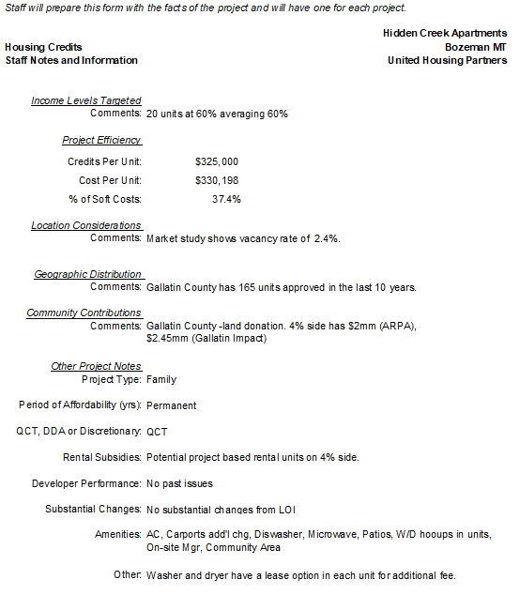
Summary Sheet & Application Packet
First Packet Released Late September
Demographic & population graph – applicable counties on top/separated
# of units in last 10 years & 4% & 9% projects by county

Slide 7
Summary Sheet & Application Packet
Second Packet Released Early October
Projects are grouped together and include:
Staff notes and information
Project Packet
Cover page
Photos
Mini Market Study Summary
Project Amenities
Public Support Letters
Board Member worksheet for notetaking
Housing Credit project list award summary
Developer past project award and completion
Spreadsheets showing project comparative information

Slide 8
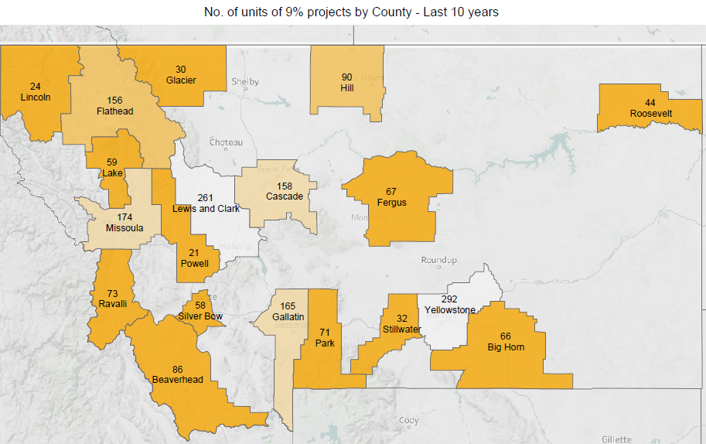
2025 Demographics 9%

Slide 9
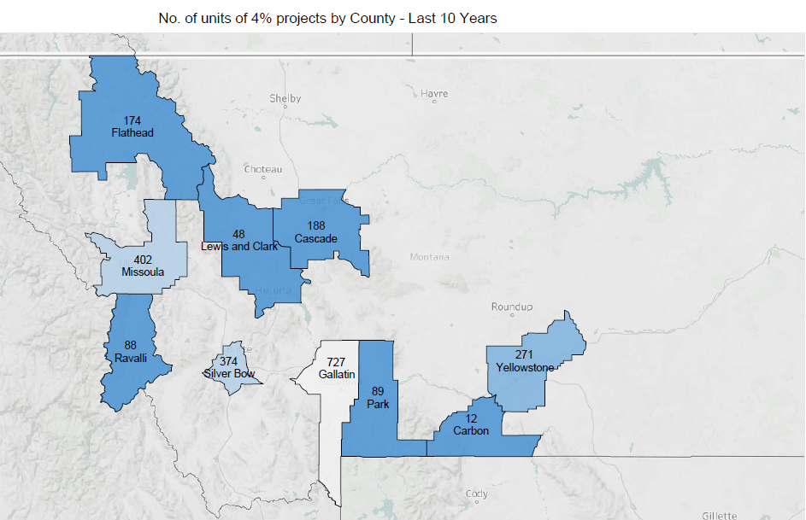
2025 Demographics 4%

Slide 10
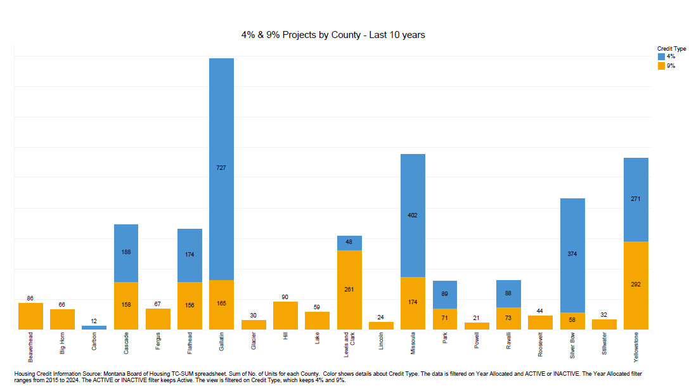
Number of Units Last 10 years

Slide 11
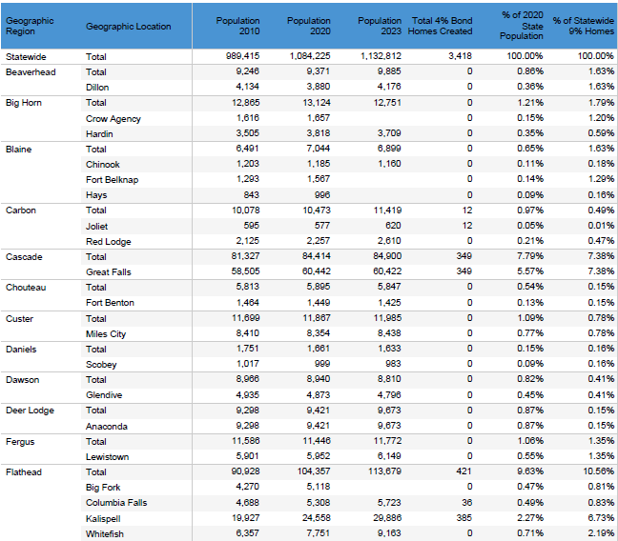

Slide 12
9% Credits
Competitive Rounds
Can subsidize 70 percent of the low-income unit costs in a project
Usually for new construction and substantial rehabilitation without federal subsidies
15-year compliance; 35-year extended use period
$8.5 million maximum allocation per project

Slide 13
Private Activity Bonds 4% Credits
Can subsidize 30 percent of the low-income unit costs in a project
Non-competitive, for now
No amount cap like competitive, Volume Cap at state level determines cap
Acquisition of existing buildings for rehabilitation and new construction financed by tax-exempt bond
15-year compliance; 35-year extended use period
No discretionary boost
“50%” Test imposes minimum debt requirements
The Board will approve a resolution to be the issuing agency for the tax-exempt bonds
Notes:
Tracking 15 deals for $470m in bonds

Slide 14
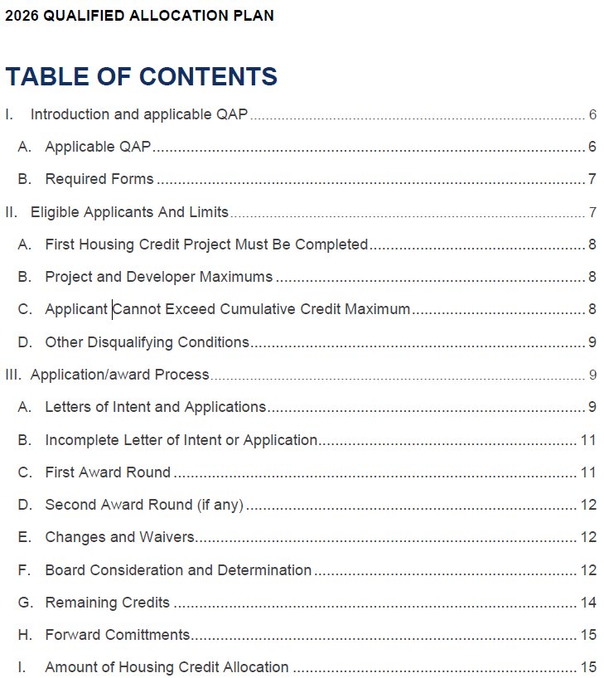
Qualified Allocation Plan (QAP)
The Qualified Allocation Plan is the governing document for Montana Housing Credits
The QAP is intended to ensure the selection of those developments which best meet the most pressing housing needs of Montanans in accordance with the guidelines and requirements established by the federal government and the requirements, considerations, factors, limitations, criteria and priorities established by the Montana Board of Housing
The QAP is updated annually, approved by both the Board and the Governor, and revised within ARM’s – including a public hearing and public comment period

Slide 15
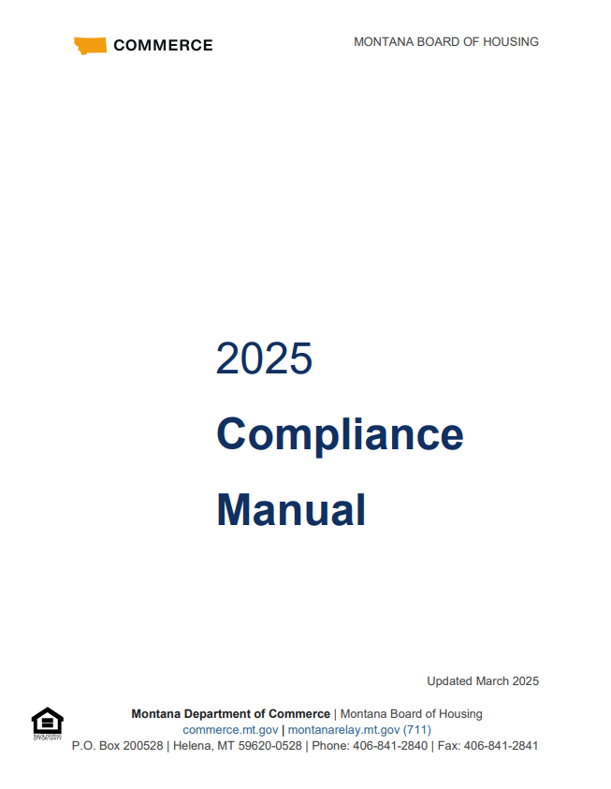
Housing Credit Compliance
Housing Credit properties are governed by Section 42 of the Internal Revenue Code. All projects are governed by promises made by the owner in their application for funding and any other more restrictive rules implemented by the Montana Board of Housing. These rules can be found in the Declaration of Restrictive Covenants
The Compliance Manual is intended as a reference to promote a better understanding of the Housing Credit program. Owners are responsible for compliance with all applicable federal and state rules and regulations that govern their properties.
Our compliance team is responsible for tracking compliance of all LIHTC properties.

Slide 16
Loan Programs
Types of Programs
Multifamily Loan Program (MFLP)
Coal Trust Multifamily Homes Program (CTMH)
Housing Montana Fund – Affordable Housing Revolving Loan Fund
Multifamily Loan Program
Loan terms of 30-year fixed rate but will consider other variations
Loan may or may not be in first lien position
Underwriting assumptions and fee limitations will follow Housing Credits. Interest rate dependent on income targeting.
2% if targeting 30% or less AMI households.
3% if targeting from 31% to 50% AMI households.
4% if targeting from 51% to 80% AMI households.
6% if targeting from 81% to 95% AMI households.
Weighted average rate if targeting multiple ranges.

Slide 17
Loan Programs Continued
Coal Trust Multifamily Homes Program
Loans must be in first lien position
Project must pay property taxes, except for tribal land
Underwriting assumptions and fee limitations will follow Housing Credits
Loan Terms are 40-year amortizations with terms up to 30 years. Interest rates are set by Board of Investments.
Housing Montana Fund (AHRLF)
Loan may or may not be in first lien position.
30-fixed rate maximum. Interest rate is dependent on income targeting like the Multifamily Loan Program.
Underwriting assumptions and fee limitations will follow the most current Qualified Allocation Plan for Housing Credits.

