Slide 1
Multifamily Program Discussion
Montana Board of Housing
Board Training & Strategic Planning
April 17, 2023
Notes:
Jason kick off

Slide 2
NCSHA Recommended Practices in
LIHTC Administration
Executive Director and Multifamily Program Manager participating in Recommended Practices Task Force to update the 2017 document
MBOH aligns with all big picture applicable recommended practices
Practices are flexible and broad so states can customize for their needs
Examples:
MBOH’s Tribal Spotlight
Broadband Inclusion
5% Rent Increase Cap
Notes:
Cheryl to provide timeline for Task Force work and little update
Jason to cover remainder of slide
Recommended Practices:
Have CNA completed by 3rd party; has similar requirements to what we already use
We also following minimum deposits for reserves
Most of MBOH QAP is very aligned with Recommended Practices; may items in other state QAPs aren’t applicable to Montana (i.e., state tax credit, minority)

Slide 3
9% Project Characteristics
9% Credits in Millions
Competitive; historically oversubscribed 3:1
Can subsidize 70 percent of the low-income unit costs
Can support deeper affordability
more units at 30 to 40% AMI
Permanent Supportive Housing
Works in urban and rural areas
Works for small and larger development sizes
Can support new construction and substantial rehabilitation
Notes:
Jason
9% credits
Annual Competitive Rounds
Subsidize 70 percent of the low-income unit costs in a project
Usually for new construction and substantial rehabilitation
15-year compliance, 35-year extended use period = 50 years of compliance
10-year credit
2024 Housing Credits to allocated in 2023 are estimated to be $31.85M
Targeting – typically 30%-60% AMI vs 4% is 60%

Slide 4
9% Project History
52 percent of units at LOI in 2022 for rehab
30 percent in 2021
29 percent in 2020
46 percent of units awarded in 2022 for rehab
36 percent in 2021
26 percent in 2020
Notes:
Jason

Slide 5
4% Project Characteristics
Noncompetitive, for now
Can subsidize 30 percent of the low-income unit costs
Better suited for higher income targeting
more units at 60% AMI
Better suited for urban areas
Works best with larger property sizes
Can support new construction and acquisition / rehabilitation
50% test imposes minimum debt requirements
Notes:
Jason
4% credits
No amount cap like competitive, Volume Cap at state level determines cap
Acquisition of existing buildings for rehabilitation and new construction financed by tax-exempt bonds
15-year compliance, 50-year extended use period
No discretionary boost
“50%” Test imposes minimum debt requirements
Most times the Board will approve a resolution to be the issuing agency for the tax-exempt bonds
4% can work well in urban areas and for larger project sizes (i.e. 120 units) but is not the best tool for affordable housing development for smaller projects or in rural communities.

Slide 6
WHAT IS THE NEED?
137,320 | Total # of Montana renter households (31% of population)
56,727 | Number of Very Low-Income renters
-12,850 | Deficit of affordable & available rental homes for VLI renters
33,598 | Number of Extremely Low-Income renters
-18,538 | Deficit of affordable & available rental homes for ELI renters
-31,388 | Shortage of affordable & available rental homes for VLI & ELI renters
Current State of Montana and Federally allocated resources can support production of approximately 500 affordable rental homes on an annual basis
HUD FY2022 Income Limits – Montana Family of Four
Median Family Income = $81,200
Low-Income (80%) = $64,550
Very Low-Income (50%) = $40,350
Extremely Low-Income (30%) = $24,200
Source: NLIHC tabulations of 2020 5-year ACS PUMS https://nlihc.org/housing-needs-by-state/montana
Notes:
Jason
Increasing the supply of affordable and attainable housing is one of Montana’s most critical needs.
According to the National Low Income Housing Coalition and available Census data, across Montana, there is a shortage of rental homes affordable and available to extremely low-income households and very low-income households.
To put into context, a very low-income family of 4 in Montana has an annual income just over $40,000; an extremely low-income family of 4 has an annual income of just $24,200.
64% of extremely low-income households and 23% of very low-income households are severely cost burdened, spending more than half of their income on housing.
Severely cost burdened households are more likely than other renters to sacrifice other necessities like healthy food and healthcare to pay the rent, and to experience unstable housing situations like evictions.
There are over 90 thousand very low and extremely low-income renter households in Montana, but there is a shortage of over 31 thousand rental homes affordable and available for these families.
Unfortunately, our current State of Montana and Federally allocated resources can only support the production of approximately 500 affordable rental homes each year.

Slide 7
Prioritization of 9% Credit
Montana is experiencing affordable housing scarcity and 9% credit scarcity.
Given this reality, should Montana’s 9% credits be reserved only for projects that are not feasible as 4% projects?
Questions for Board Member consideration:
Will the proposed project deliver new housing supply?
Could the project be financed with 4% credits and bonds instead?
Does the proposed project target deeper affordability (more units at 30 to 40% AMI) and/or a commitment to serve homeless and/or persons with disabilities?
Does the proposed capital stack maximize leverage other non-Housing Credit sources?
Notes:
@Adam with CSG to touch on housing scarcity / credit scarcity lens approach
Jason to pose questions for open discussion

Slide 8
Preservation Trade-Offs
Questions for Board Member consideration:
Is the proposed preservation project at imminent risk of conversion to market rate with loss of federal rental subsidy if funds are not allocated the year requested?
Consider prioritization for preservation projects at imminent risk of losing federal rent subsidies
If the project is already in the MBOH portfolio, has the project completed its initial 15-year compliance period? If yes, what year are they in under the Extended Use Agreement?
Consider use of 4% / bonds for resyndication?
How are the project’s current physical conditions described in the Capital Needs Assessment (CNA)? Does the property have imminent health and safety issues?
Does the proposed scope of work align with the physical conditions needs described in the CNA?
Future update to QAP: Replacement reserve to stay with project at year-15 exit.
Notes:
Jason lead
Mark, Adam and Cheryl to chime in with perspectives

Slide 9
Permanent Supportive Housing
What is PSH?
Permanent housing in which housing assistance (e.g., long-term leasing or rental assistance) and supportive services are provided to assist households with at least one member (adult or child) with a disability in achieving housing stability.
https://www.hudexchange.info/homelessness-assistance/coc-esg-virtual-binders/coc-program-components/permanent-housing/permanent-supportive-housing/
A Continuum of Care program component type providing indefinite leasing or rental assistance combined with supportive services for disabled persons experiencing homelessness so that they may live independently.
https://files.hudexchange.info/resources/documents/Virtual-Binders-Glossary-of-Terms.pdf
Notes:
Cheryl to cover definitions
Touch on whether 100% PSH or set-aside like 20%
Mark and Adam can weight in

Slide 10
Permanent Supportive Housing
How are we currently approaching PSH? Excerpt from current QAP:
For Permanent Supportive Housing, Owners and Management Companies will:
not give a preference based on disability type (actual or perceived) or being a client of a particular service provider;
use standard leases with the same rights available to and responsibilities expected of other households, including duration of tenancy (cannot be transitional);
ensure participation in any supportive services is entirely voluntary (not a formal or implied condition of occupancy);
not segregate units within the Project; and
not engage in medical, therapeutic, or other activities regulated by the U.S. Centers for Medicare & Medicaid Services with respect to the tenants.
Notes:
- Mark to elaborate

Slide 11
Permanent Supportive Housing
NCSHA Recommended Practices in LIHTC Administration (2017). HFAs should:
“analyze recent state experience in using the Housing Credit for supportive services and consider QAP incentives or other policy initiatives to ensure such housing needs are adequately addressed.”
“work with interested stakeholders and program investors to study current impediments to supportive housing development and make appropriate changes to underwriting criteria or other policies to maximize investor interest in these developments.”
“ensure that supportive housing developments have the capacity to deliver appropriate resident services by requiring service delivery experience among the proposed development team or from identified service providers.”
“consider implications of the U.S. Supreme Court’s Olmstead decision relating to appropriate housing for persons with disabilities to ensure that supportive housing developed using the Housing Credit is consistent with this ruling.”
Notes:
Cheryl to cover and elaborate on Interdepartmental Housing Integration Project (IHIP) – intersection of housing and healthcare (Montana Healthcare Foundations; Corporation for Supportive Housing)
NCSHA Recommended Practices in LIHTC Administration 2022-2023 Task Force has not discussed supportive housing recommended practices yet.

Slide 12
Permanent Supportive Housing
Questions for Board Member consideration:
How should MBOH approach underwriting of PSH projections in the following areas?
Sponsor Experience
Service Provider Experience
Property Management Experience
Market Demand
Supportive Services Plan
Onsite Management / Security
Supportive Services Underwriting
Reserves & Guarantees
Are there any adjustments to the QAP we would want to consider?
What does the typical permanent lender / equity investor consider?
Notes:
@Adam to elaborate on observations from national perspective – esp. touch on what does typical permanent lender / equity investor consider question.
@Mark to elaborate on perspective for separation of housing from service component
Notes from CSG:
Sponsor Experience
Standard from CSG: Sponsor should have experience developing both LIHTC and PSH (e.g., on at least two other projects) or should partner with a co-GP that provides such experience.
Service Provider Experience
Standard from CSG: Service provider should have experience providing services to the target population and, preferably, working with the relevant local agencies (e.g., local department of public health or coordinated entry system)
Property Manager Experience
Standard from CSG: Management company should have experience managing LIHTC housing and coordinating with service providers (e.g., on at least two other projects).
Market Demand
Standard from CSG: Market study should demonstrate (1) high demand in the local market for affordable housing and supportive services and (2) low capture rates for PSH unit sizes (typically studio/1BR units).
Services Plan
Standard from CSG: There should be a written plan in place to ensure that PSH tenants are connected with appropriate services (whether by onsite/affiliated providers or offsite/unaffiliated providers), and such plan should be approved by the local social service contracting agency if required.
Desk/Onsite Management/Security
Standard from CSG: The staffing plan and operating budget should provide for a combination of front- desk management staffing, live-in property management, and security to ensure 24-hour coverage of resident needs.
Subsidy Underwriting
Standard from CSG: Rents should be underwritten at or below the LIHTC maximum to ensure the project can remain viable if PSH subsidy is lost.
Reserves and Guarantees
Standard from CSG: Project should have sufficient reserves and/or guarantees from a financially strong sponsor to cover shortfalls or delays in any ongoing PSH operating subsidy.

Slide 13
HOME-American Rescue Plan (HOME-ARP)
Purpose: Congress appropriated $5 billion in ARP funds to be administered through the HOME Investment Partnership Program (HOME) to primarily address homelessness and supportive services needs.
Allocation: State of Montana will receive $11,459,768
Five (5) percent now available for administrative costs ($572,988)
Additional 10 percent ($1,145,976) available for administrative costs after HOME-ARP Allocation Plan approved by HUD.
Regulations: HOME regulations apply except waivers provided by HUD, including no 24-month commitment deadline, no match requirement, and no per unit subsidy limit.
Expenditure: HUD expenditure deadline September 2030
Notes:
Cheryl to cover HOME-ARP
- Touch on application timeline
Remaining allocation, including 10% additional Admin ($1,145,976), available after HOME-ARP Allocation Plan approved by HUD
Allocation Plan uploaded to IDIS as a substantial amendment to 2021 Annual Action Plan
Certifications uploaded to IDIS
HUD reviews, approves, makes funds available
HOME regulations (24 CFR 92) apply except where waivers are provided by HUD
Where regulations reference CHDOs, for HOME-ARP, that equates to non-profits
No 24-month commitment deadline
No CHDO set-aside
No Match requirement
No per unit subsidy limit
Master leases for nonprofits allowed; sublease for qualifying households
15-year restricted use for housing; 10 or 15-year for non-congregate shelter
NOT waived: Environmental, fair housing, labor standards, relocation, lead paint, Section 3, conflict of interest regulations

Slide 14
QUALIFYING POPULATIONS
Qualifying Populations must occupy 70% of the HOME-ARP assisted units
Homeless as defined at 24 CFR 91.5
At risk of homelessness as defined at 24 CFR 91.5
Fleeing or attempting to flee domestic violence, dating violence sexual assault, stalking or human trafficking
Other households requiring services or housing assistance to prevent homelessness
Other households at greatest risk of housing instability
Veterans and families that include a veteran family member
Low-income households, who are not otherwise qualifying populations, may occupy up to 30% of the HOME-ARP assisted units

Slide 15
ELIGIBLE ACTIVITIES
Development of rental housing (single or multi-family) - $7,013,792 proposed to HUD
Acquisition, development, refinancing, related soft costs, relocation, capitalization of an operating reserve, ongoing operating cost payments
Development of non-congregate shelter - $2,000,000 proposed to HUD
Acquisition, demolition, development, related soft costs, capitalization of a replacement reserve
Supportive Services - $1,300,000 proposed to HUD
McKinney-Vento Supportive Services
Homelessness Prevention Services as defined under ESG
Housing Counseling Services by HUD-certified for homebuyer or renters
Administration and Planning - $1,145,976 proposed to HUD
Notes:
Ineligible uses:
Homeownership activities (development or down payment assistance)
Converting NCS to housing
Operating NCS
HOME-ARP allocation plan was submitted to HUD and we are waiting for their review and approval (anticipated April 21)

Slide 16

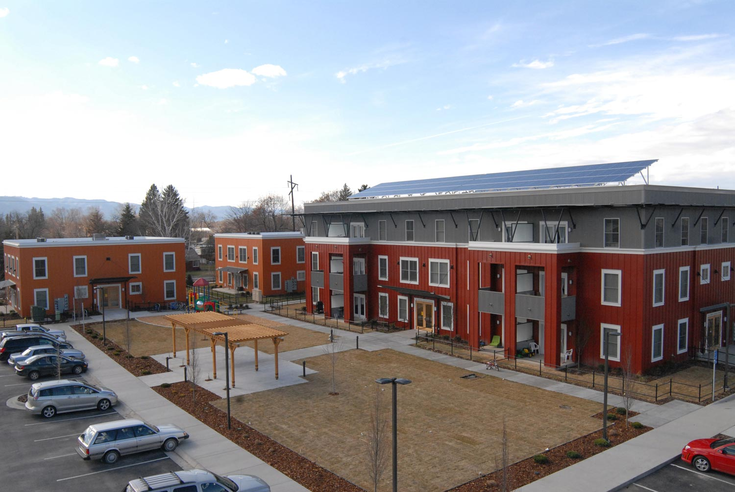
FOR MORE INFORMATION
MONTANA HOUSING
Montana Department of Commerce
HOUSING.MT.GOV
406.841.2845
Jason Hanson
Multifamily Program Manager

